Slide 1
Handwriting Recognition (HWR)
ZHIJIAN,DAI (David)

Slide 2
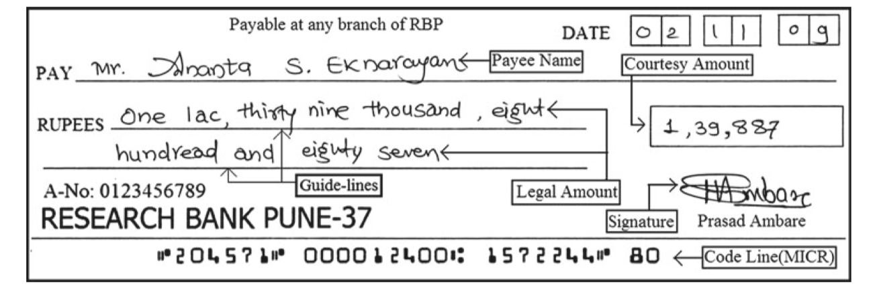
The problem
Bank Cheque, Application form, Exam answer paper
Result can be easily affected
Blur Image, Low contract, Image Noise

Slide 3
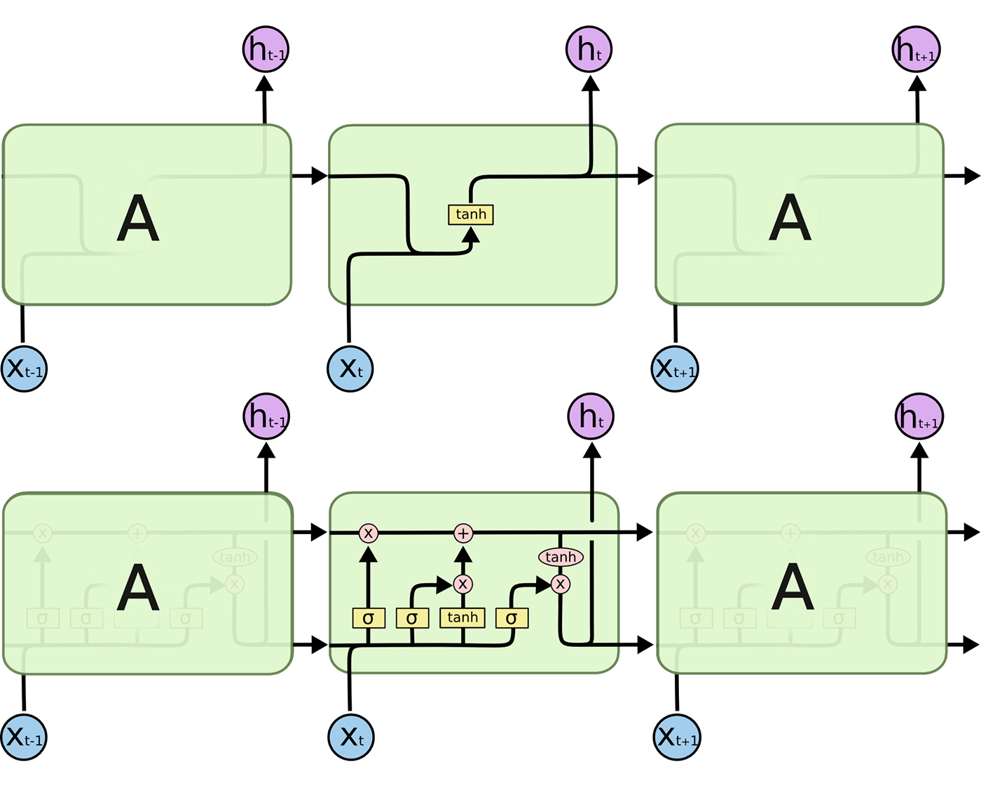
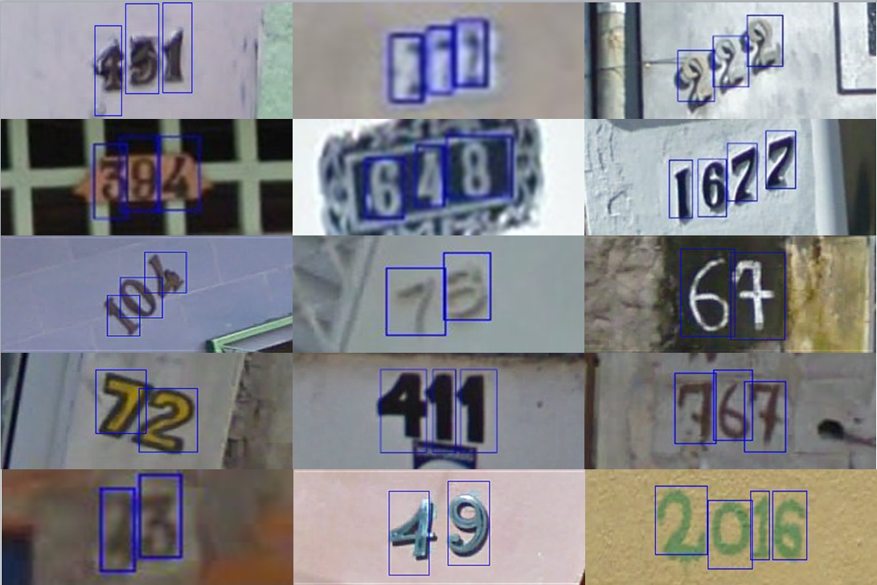
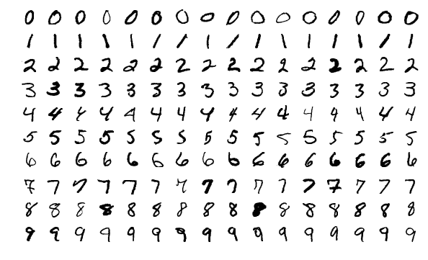
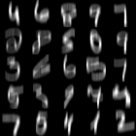
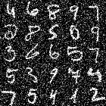
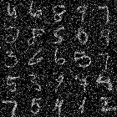
The solution (outline)
Model: RNN
Public Datasets: MNIST, Noisy–MNIST, SVHN
RNN
SVHN (Street View House Number)
MNIST
Noisy-MNIST Motion Blur
Noisy-MNIST Additive White Gaussian Noise (AWGN)
Noisy-MNIST reduced contrast and AWGN

Slide 4
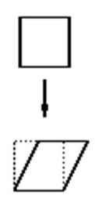
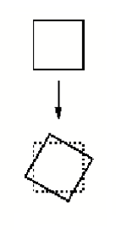
The interesting implementation stuff
Data Augmentation
Affine
Random Rotation
Color Jitter
Using Different Dataset combine with data augmentation getting best training model
For example: MNIST as trainset against Noisy-MNIST as testSet or Noisy-MNIST against Street View House Number
Data Augmentation can affect the test result
Affine
Random Rotation

Slide 5
Quantitative evaluation
TrainSet\ TestSet | MNIST | RC | MB | WGN | SVHN
MNIST | 95.88% | 48.05% | 93.16% | 59.82% | 17.40%
RC | 96.63% | 94.83% | 94.99% | 96.15% | 18.38%
MB | 96.18% | 66.12% | 97.66% | 81.40% | 18.13%
WGN | 96.63% | 95.32% | 93.54% | 97.15% | 17.96%
Combined | 98.16% | 96.88% | 98.26% | 98.38% | 23.63%
RC = Reduce Contract and Additive White Gaussian Noise
MB = Motion Blur
WGN = Additive White Gaussian Noise
SVHN = Street View House Number
Combined = RC + MB + WGN

Slide 6
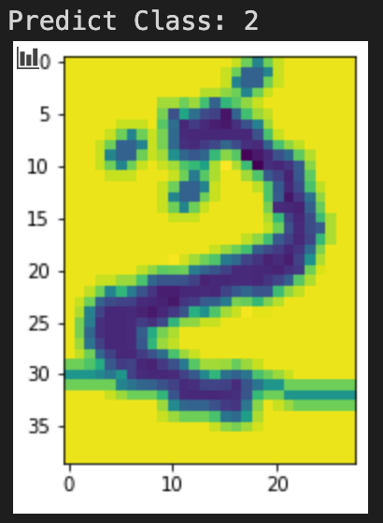
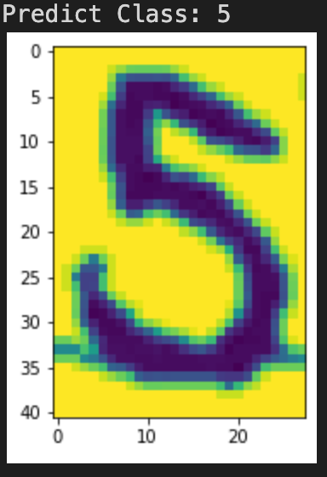
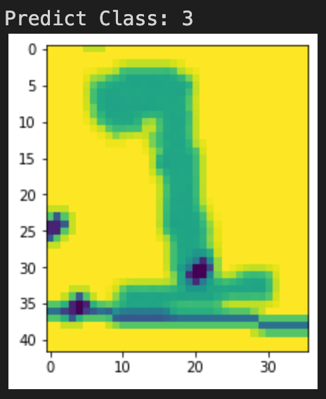
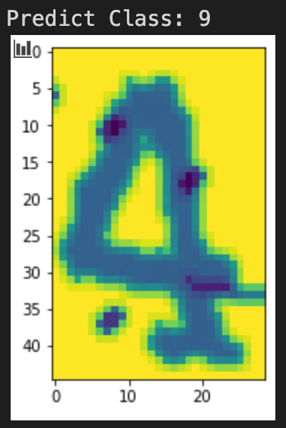
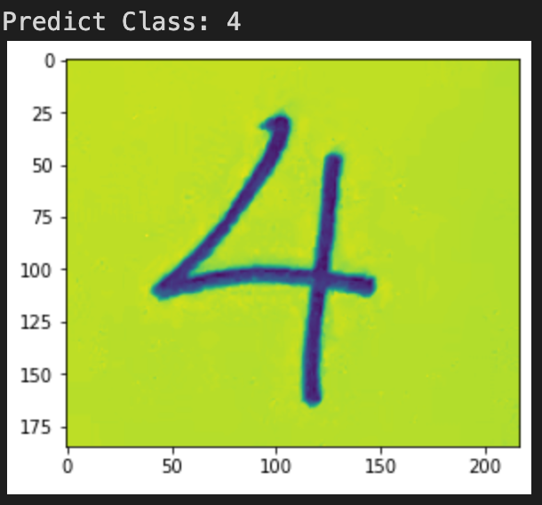
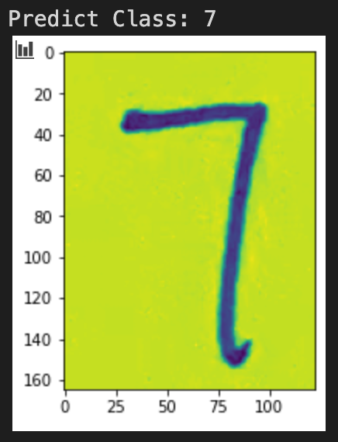
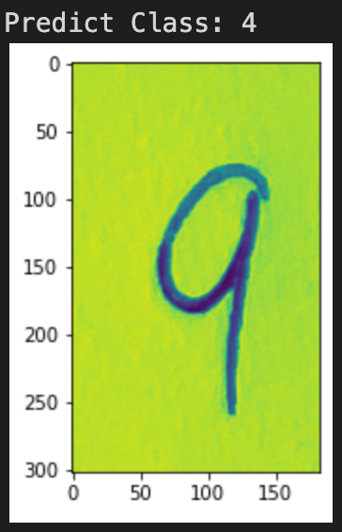
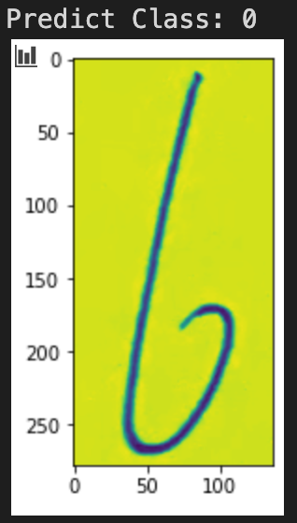
Qualitative evaluation
Correct Examples
Train: Noisy-MNIST Combined
Test: MNIST
Bad Examples
Train: Noisy-MNIST Combined
Test: SVHN

Slide 7
Thanks for listening. Any Questions?

